Slide 1
Engaged & Resilient: Network Boards
NCHN Conference
Mary Kay Chess, PhD
April, 2012

Slide 2
Agenda for Today
Defining Boards as High Performing Teams
Board Structures Supporting Engagement & Resiliency
Tools for High Performing Boards: Stickiness

Slide 3
“The people who are crazy enough to think they can change the world are the ones who do.” Apple’s THINK DIFFERENT commercial, 1997.

Slide 4
Network
Board Frames
Define and Determine Focus of this Conversation.
Notes:
There are 4 frames for building engaged and resilient and engaged board We are looking at one frame. You are not rebuilding Rome. You are agreeing to support thoughtful change through engagement or……….SCOPE. Truth – always changing

Slide 5
Network Board Framework
Legal Configuration
Job Descriptions & Bylaws
Succession Plans & Strategic Plans
Notes:
What we are NOT talking about:
Legal: Heman Marshall – NCHN resource; Review Annually – always changing. New legal frameworks in Oregon and Washington

Slide 6

Notes:
We are going to look at a 4th frame for Boards: The How they engage and contribute to the network. Energy & Engagement so you create structure supporting this

Slide 7
1. Can Network Boards be HP Teams?
What is the definition of a high performing team?
What are the characteristics?
Notes:
HBR in April 2012 has a article on The New Science of Building Great Teams: You are looking for Charismatic connectors! Circulate actively, engage people in short, high-energy conversations, communicate with everyone and make sure all team members get a chance to communicate: energized and focused listening.

Slide 8
Features of a HP Team - BGI
HP Team: 5 -12 individuals with…
Purpose & Direction: Compelling
Leadership: Shared
Structure: Just-enough
Engagement: Full & Curious
Differences: Encouraged
Output: Unexpected Learning & Rule #6
Relationships: Strengthened
Outcome: ROI
Notes:
BGI students drawing on Senge, Hackman and Bellman & Ryan developed this criteria and tested it. If you have more than 12 you have congress – enough said.

Slide 9
Team Performance
Curve
High-Performing Team
Real Team
Performance Impact
Working Group
Potential Team
Pseudo-Team
Team Effectiveness
adapted from the ideas of Katzenbach and Smith
Notes:
Journey: time and focus, assessment and plan and action review.

Slide 10
High Performance Teams:
Deliver
Commit
Results
Trust
Conflict-
Yes
Prefer-ences
Notes:
Patrick Lencioni, The Five Dysfunction of a Team: Absence of Trust, Fear Conflict, Lack Commitment, Avoid Accountability, Inattention to Results

Slide 11
Why bother with Preferences…
Recognize fundamental variations in the ways members all approach the board
  How they are energized
  How they perceive & collect data
  How they make decisions
  How they organize our lives
Develop clearer understanding of self in relation to others on the board
Leverage differences for board/team learning and performance
Notes:
Preferences and Conflict – embracing differences. We’ll talk later – if you don’t have this – use your round tables differently or bring in advisors

Slide 12
Team Agreements: Innovate
Individual & Collective Accountability
  We will support each other strategically to learn and achieve our board goals
  We will help each other to realize our full potential
Respect: Possibility & Ambiguity
  We will respect each others’ confusion
  We will create an environment of trust so creativity is encouraged
Work Together to Deliver, Celebrate & Evaluate
  We will encourage, support and be accountable to each other
  We will help respectively resolve whatever confusion is in the room
Notes:
This helps to create the job deceptions, vision and mission and values

Slide 13
2. Network Board Structures
Rate Board Efficiently
Rate Board Energy
Rate Board Communication
Rate Board Engagement
Notes:
Use a 1-5 and 5 is high/outstanding and 1 is poor/non-existent

Slide 14
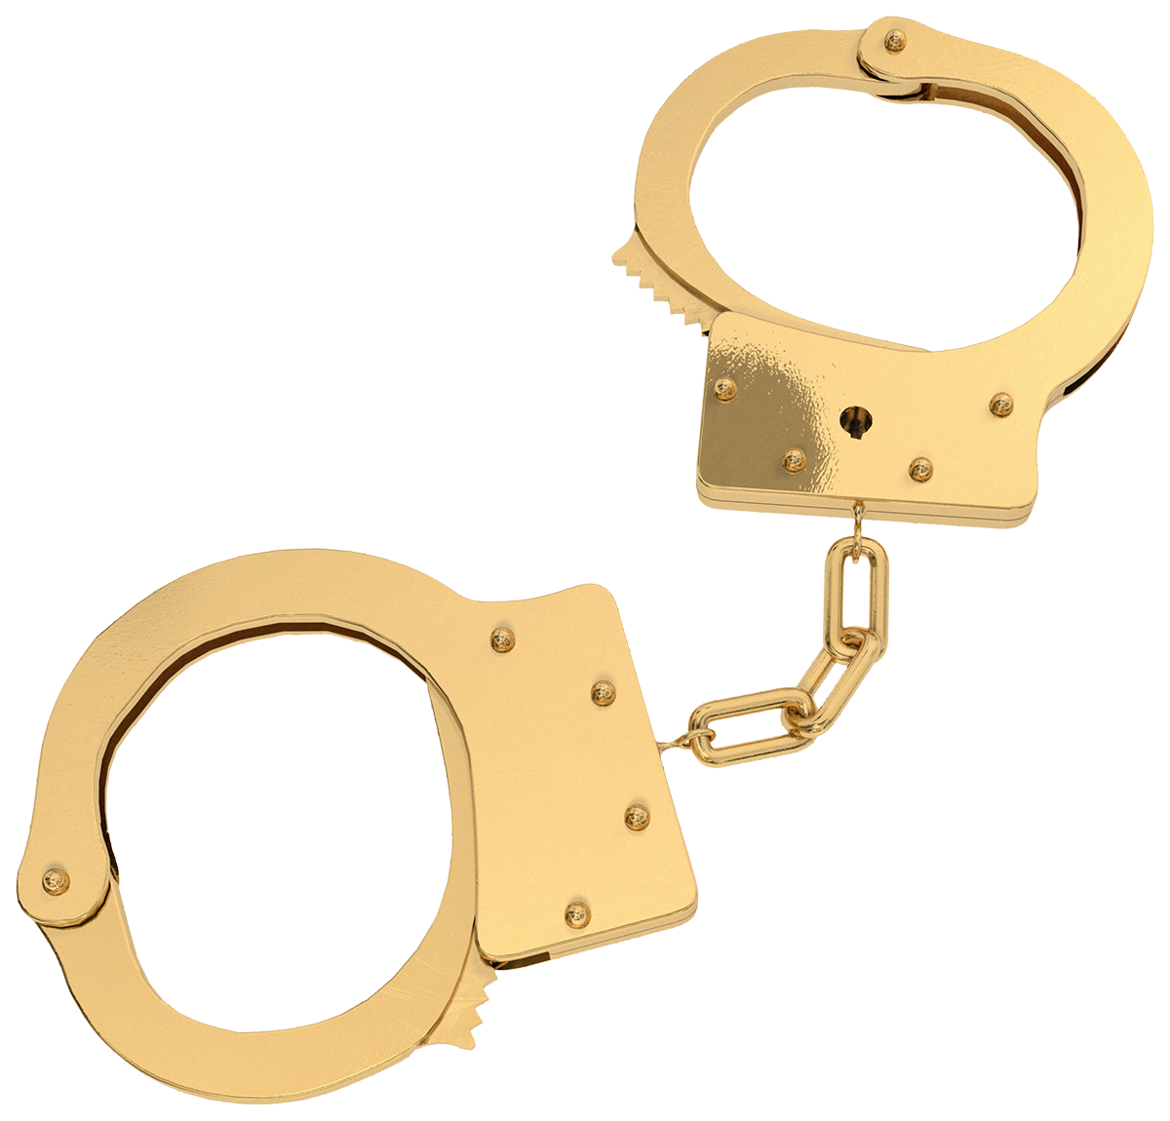

Member: Time & Commitment
Network
Their Board

Slide 15
Rate: 1(poor) & 5(outstanding)
 | Your Assessment | Board Assessment | Sept. 2012
Efficiency
Energy Level
Communication
Engagement

Slide 16
Human Mapping: Data

Slide 17
Time: (10 minute slots)
Board Members | Topic | Talking | Technology Check
Sam
Dick
Harry
Mabel
Notes:
This backs you into your ability to create job descriptions.

Slide 18
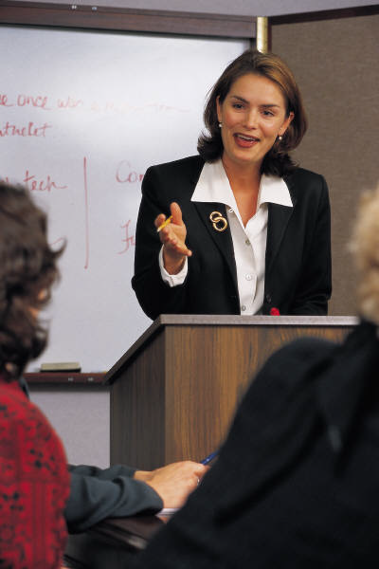
Communication
Builds Effective Teams:
Face-to-Face
Notes:
Energy: Face to face; Phone/video conference; and email/texting.
Engagement – who is talking with who
Exploration – building conversations outside the team

Slide 19
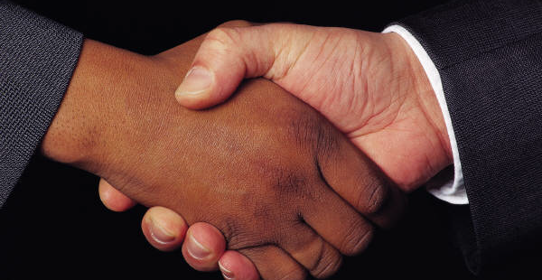
Use of Advisors & Meetings at Meetings.
Notes:
Have your boards get together. Leadership training, rural policy meeting, subgroups.

Slide 20
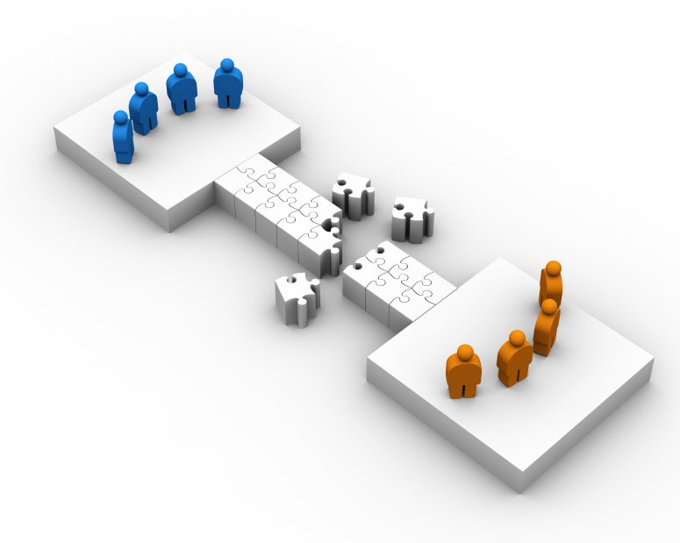
Board Change: A Destination, and maybe, a Roadmap.

Slide 21
3. Tools for Network Boards
Stickiness for High Performance

Slide 22

Thank You!
Marykaychess@comcast.net
360.331.3605

